Slide 1
Analyzing the Analyzer
Harshal
Nikitha
Palak
Sucheta
Shipra

Slide 2
Overview
Kaggle is the world's largest Data Science platform with more than 1 million users, and it is an excellent platform for students to learn and grow in the field of Data Science and Machine Learning.
Kaggle conducted an industry-wide survey to establish a comprehensive view of the state of data science and machine learning.
This survey received 16,716 usable respondents from 171 countries and territories. If a country or territory received less than 50 respondents, we grouped them into a group named “Other” for anonymity.

Slide 3
Our Dataset !!
We have used dataset of a survey conducted by Kaggle to know the users of data, what is happening at the cutting edge of machine learning across the industries and how new data scientists can break into the field.
It includes 5 files: - Schema.csv, multipleChoiceResponses.csv , conversionRates.csv, RespondentTypeREADME.txt, freeformResponses.csv.

Slide 4
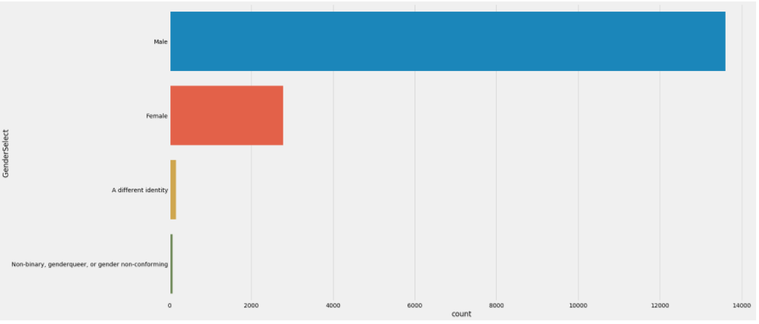
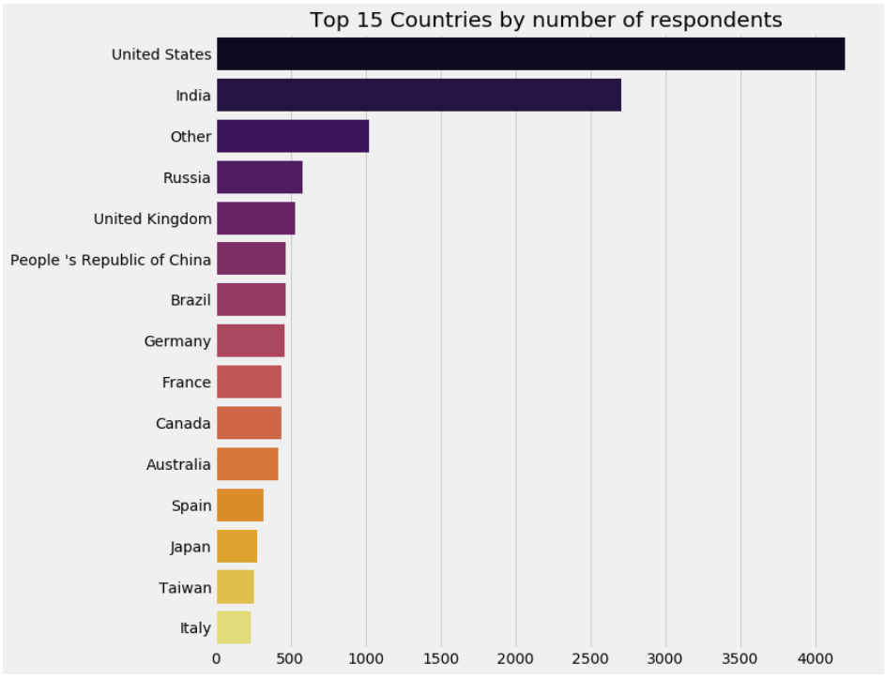
RESPONDENTS BY CATEGORY

Slide 5
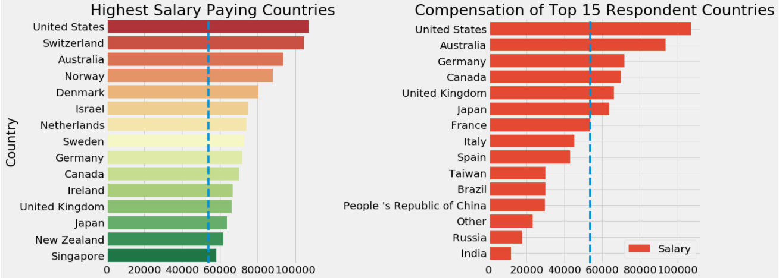
HIGHEST SALARY VS COMPENSATION

Slide 6
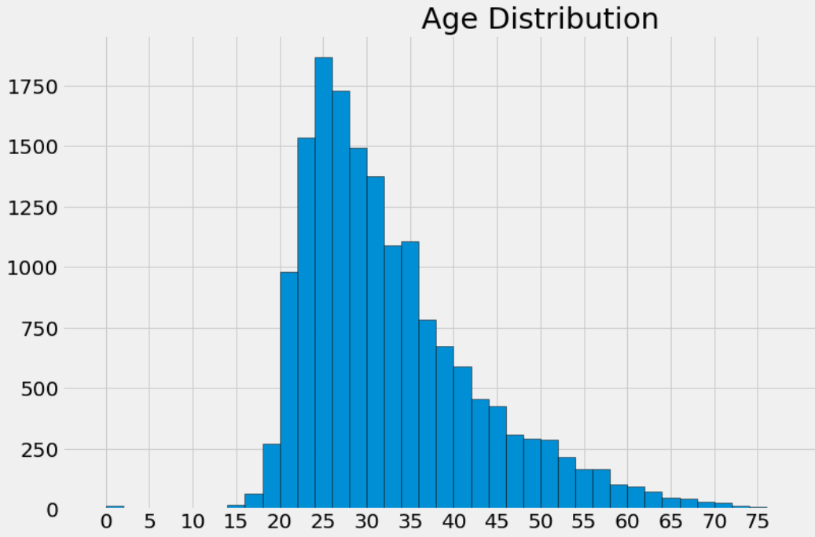
AGE DISTRIBUTION

Slide 7
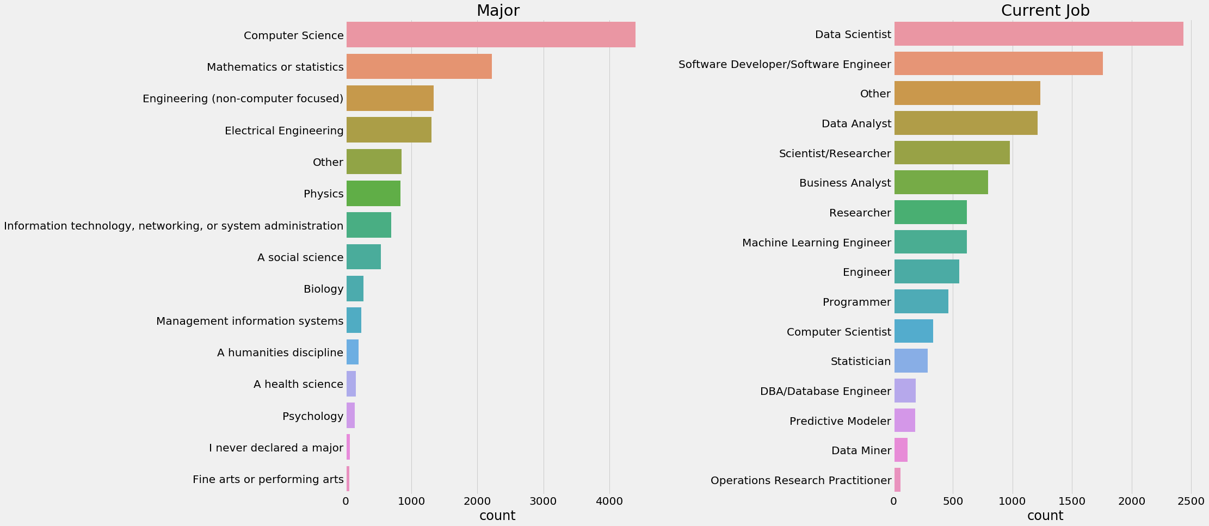
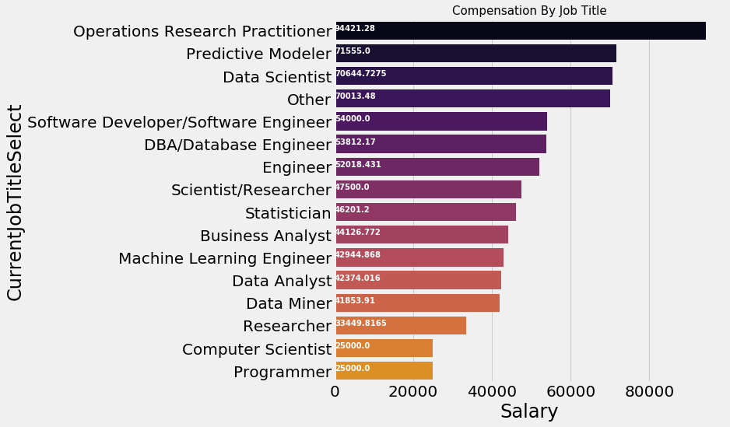
PROFESSION AND COMPENSATION

Slide 8
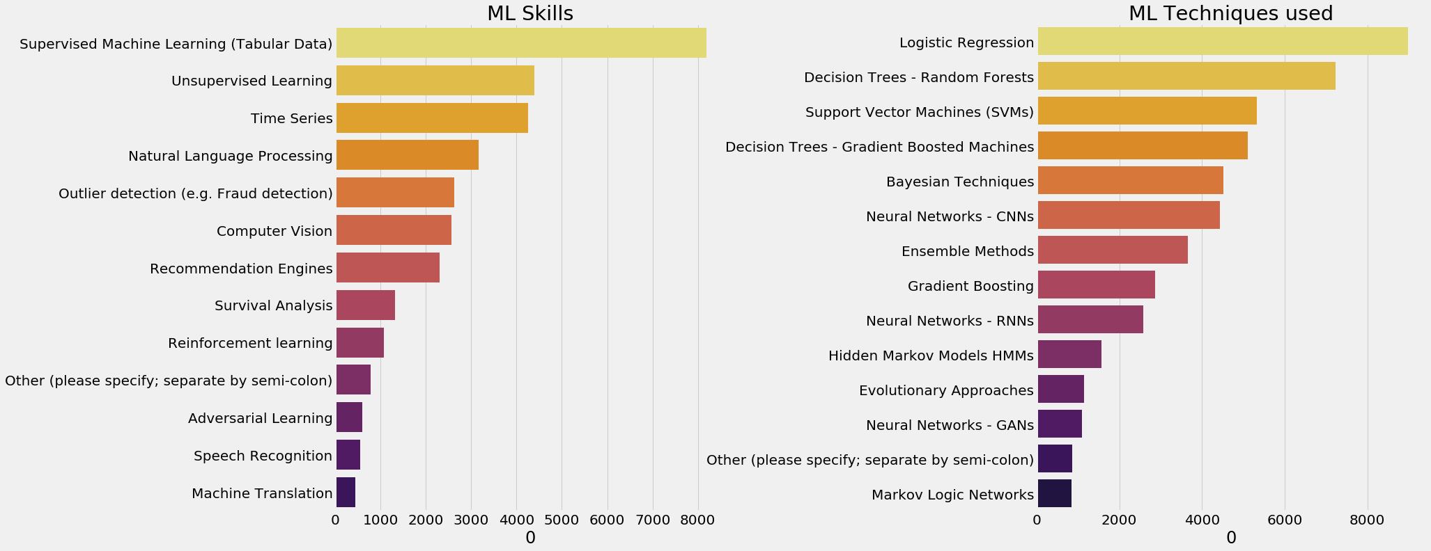
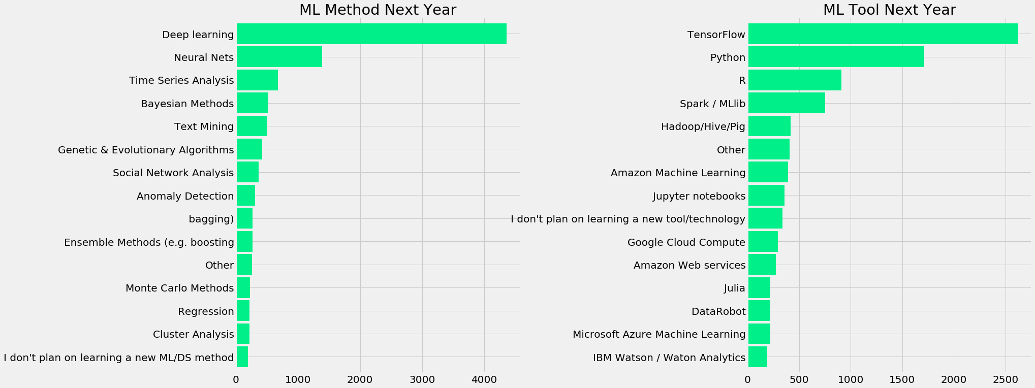
MACHINE LEARNING !!

Slide 9
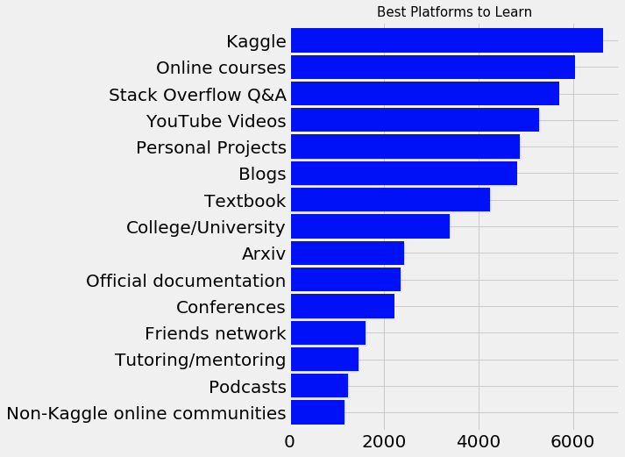
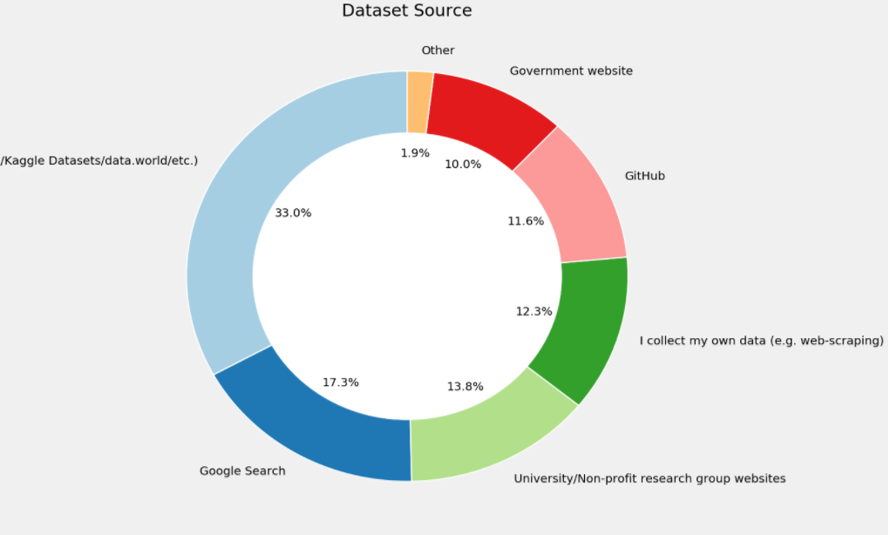
DATASET PLATFORM

Slide 10
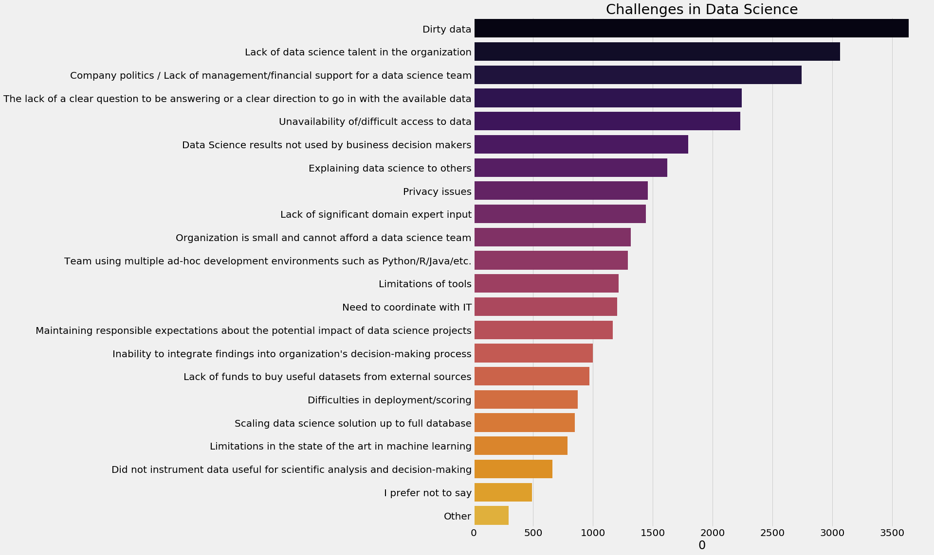
CHALLENGES IN DATA SCIENCE

Slide 11
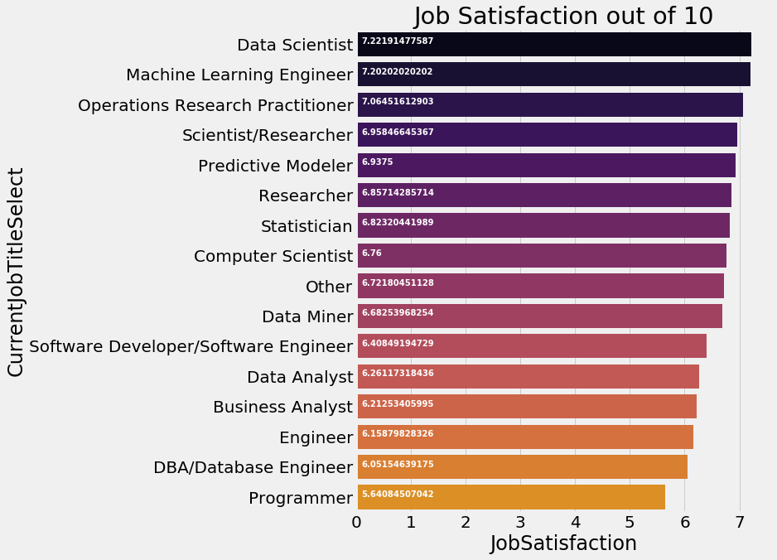
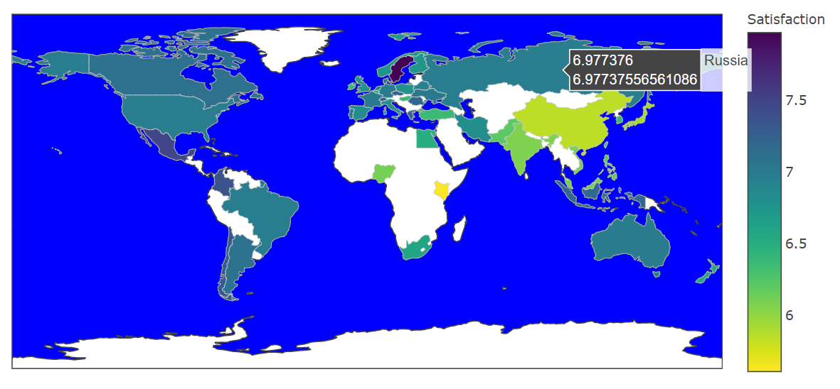
JOB SATISFACTION

Slide 12
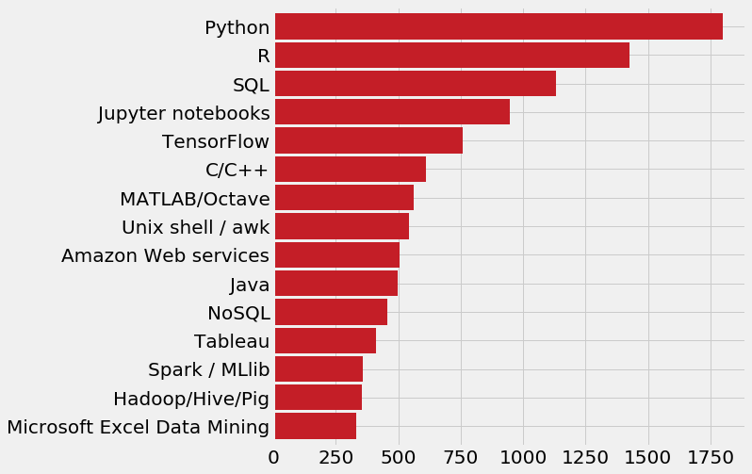
RECOMMENDED LANGUAGES

Slide 13
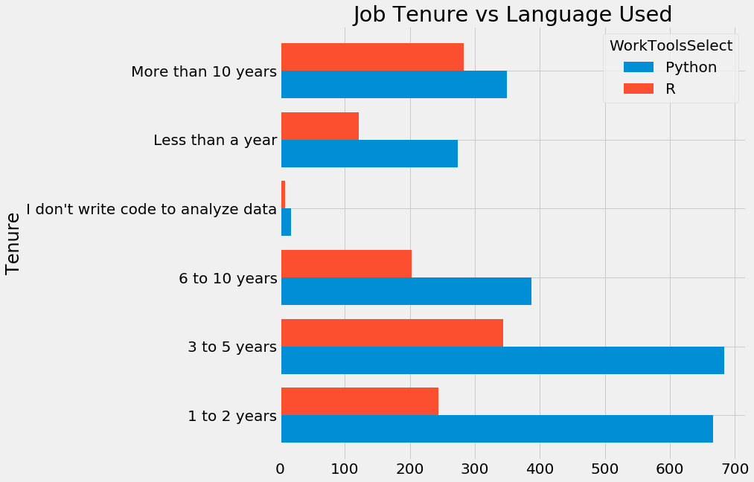
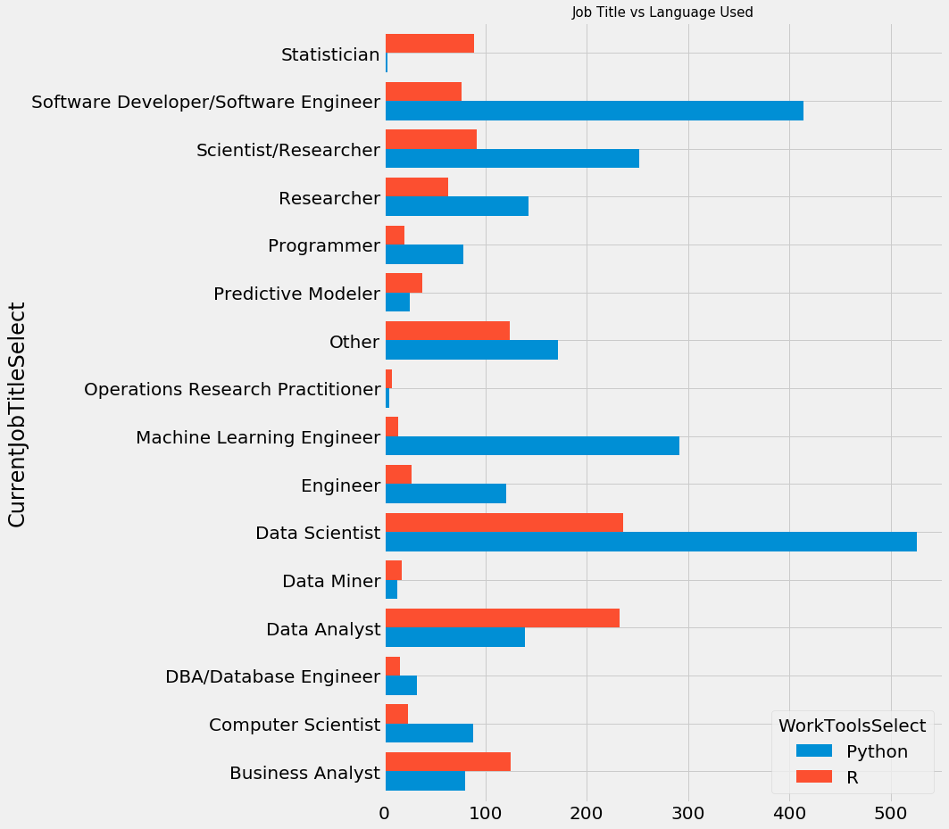
PYTHON VS R

Slide 14
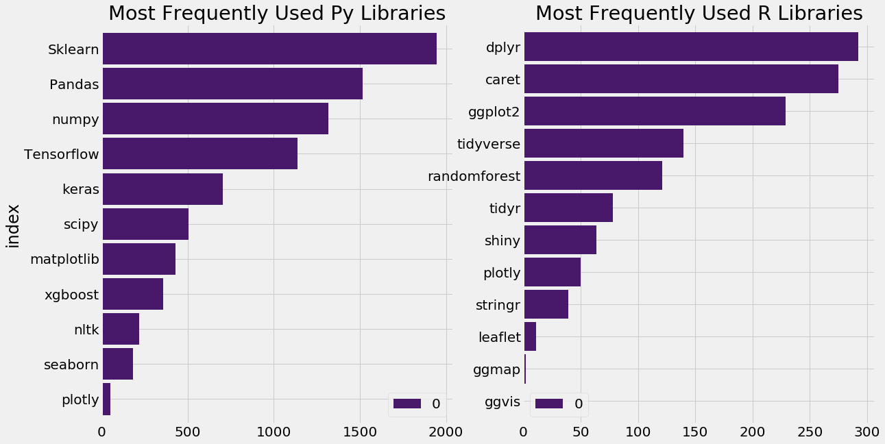
FREQUENTLY USED LIBRARIES

Slide 15
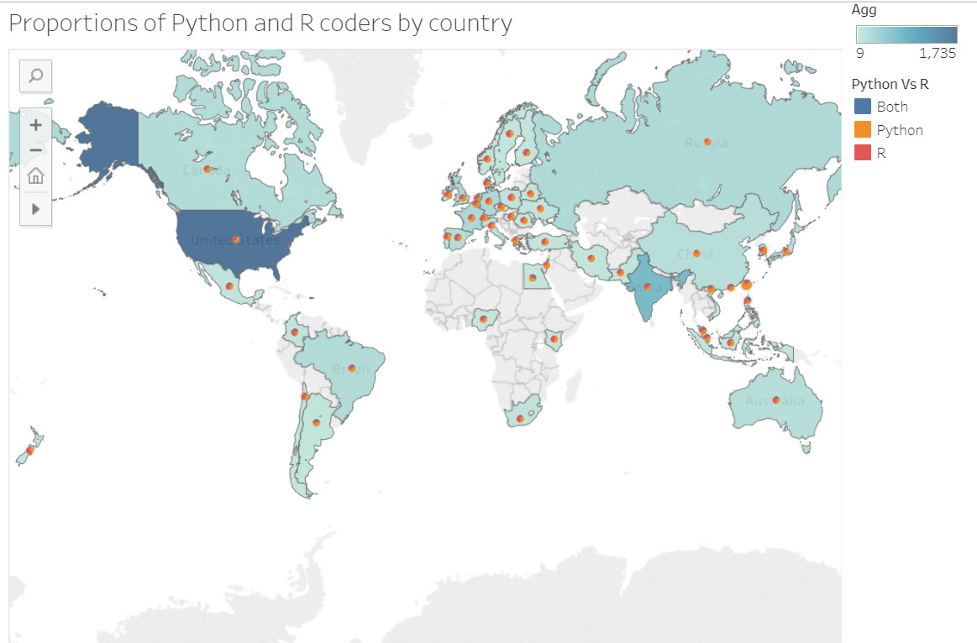
CODERS BY COUNTRY

Slide 16
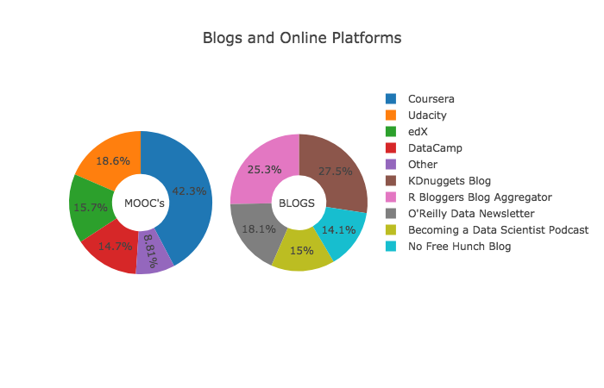
PLATFORMS
Coursera is the most favored platform by Data Scientists for learning Data Science.
WE can learn things from scratch to advanced on the same platform. It is not limited to a single language like Python or R, but also has courses covering other languages like Scala, etc.
Similarly KDNuggets is the most preferred blog.

Slide 17
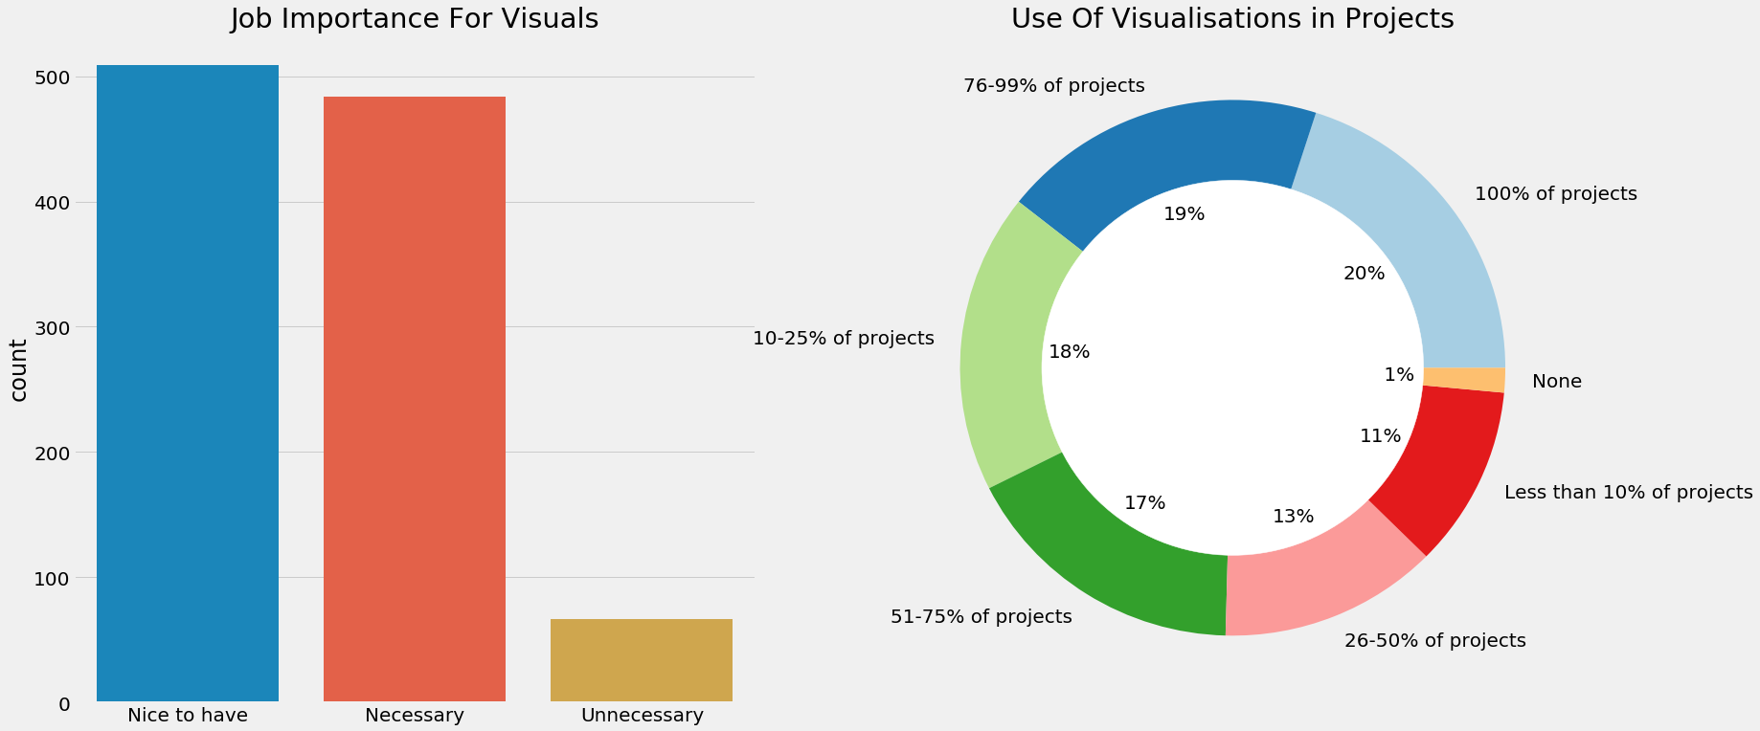
VISUALIZATION

Slide 18
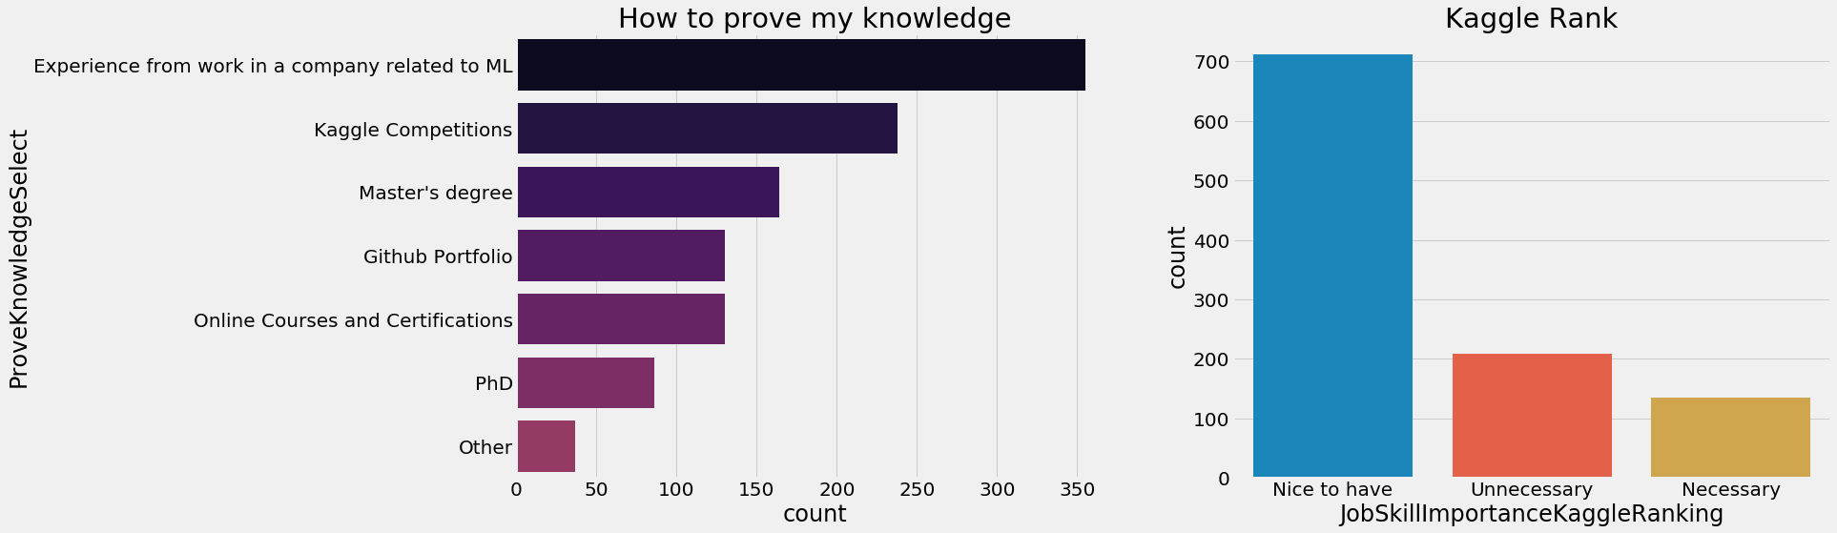
WHAT SHOULD YOUR RESUME INCLUDE??!!

Slide 19
PREDICTIVE MODELLING
Our dataset only contains categorical variables (even the age was binned at some point).
Label encoding AND One Hot encoding :
Performed one hot encoding for all the categorical variables and built a training and a test set.
Logistic Regression : Sparsity : 91.41%
Accuracy achieved by the classifier: 76.24%
Precision achieved by the classifier: 68.48%
Recall achieved by the classifier: 59.43%
Logistic regression is the easiest and most simple classifier to build and understand
We only selected 18 demographic features and one hot encoded them

Slide 20
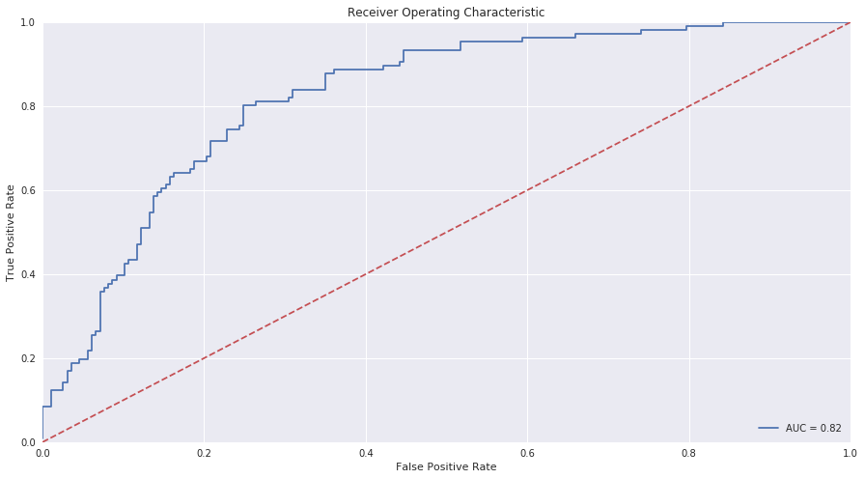
ROC CURVE

Slide 21
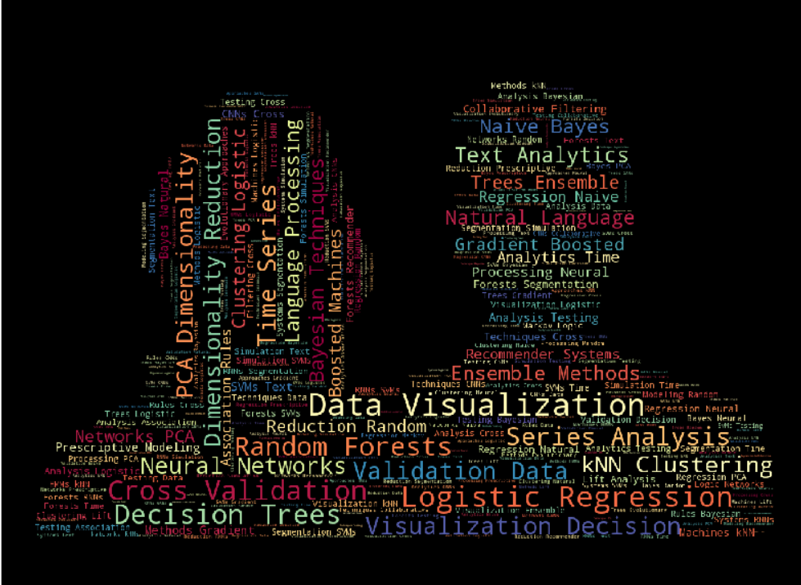
CONCLUSION
This survey's result gives an interesting insights that could give anyone a better understanding about the Data Science world, be it from a worker point of view or a learner's one.
Expose various data analysis / visualization tools for data science beginners.
Tips for budding Data Scientists : Learn Python, R and SQL Projects are the best way to learn Data Science Experience with ML Projects in company and Kaggle Competitions.

